Slide 1

Product Design and Marketing Optimization

Slide 2
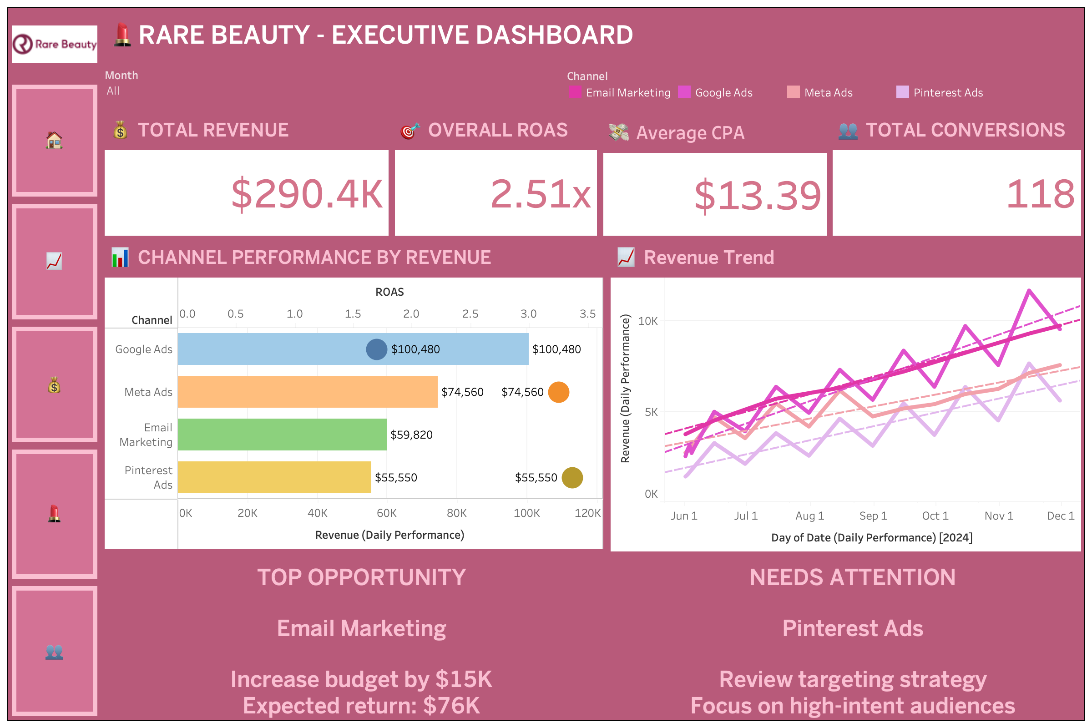
Insights
Google Ads led with over $100K in revenue
Email Marketing stood out a $15K budget increase could return $76K 📈
Pinterest Ads lagged → poor targeting, diluted spend
Takeaway: Allocate more to email and rework Pinterest strategy.

Slide 3
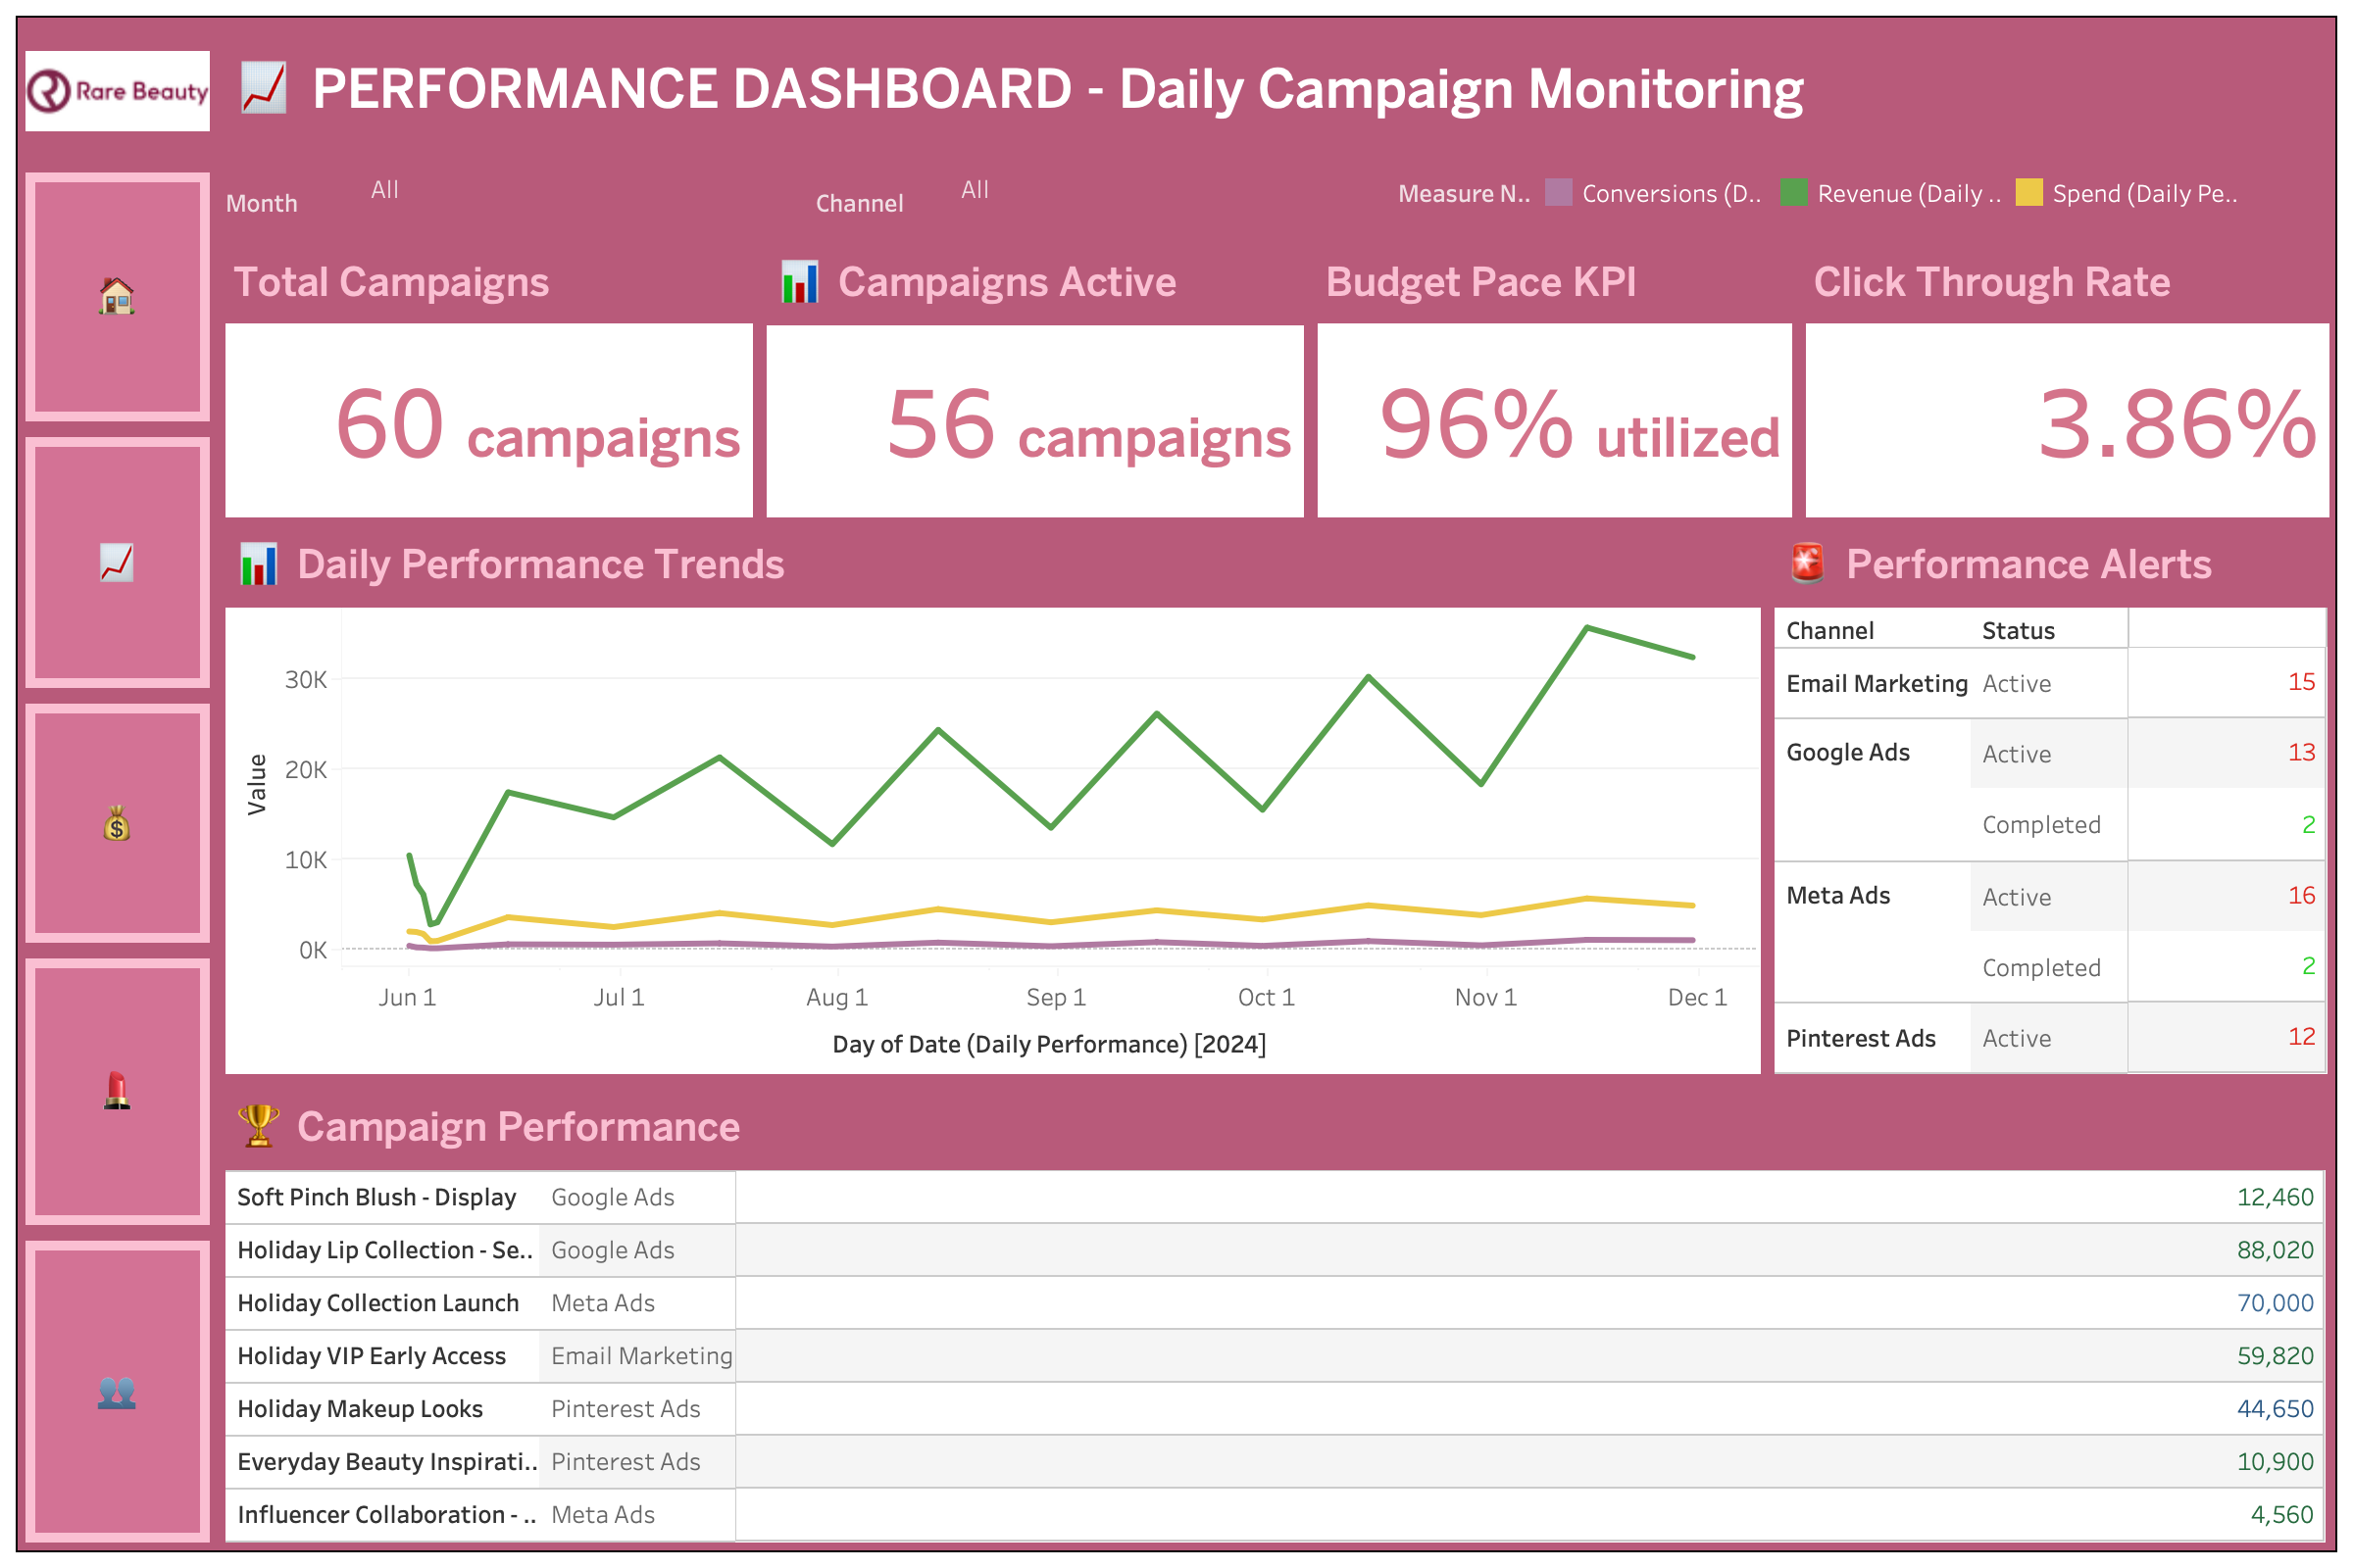
Insights
60 campaigns launched, 56 active
96% budget utilization → strong pacing
CTR: 3.86%, but multiple campaign alerts 🚨
Takeaway: High activity, but alert frequency shows creative fatigue & misaligned targeting. Real-time optimization needed.

Slide 4
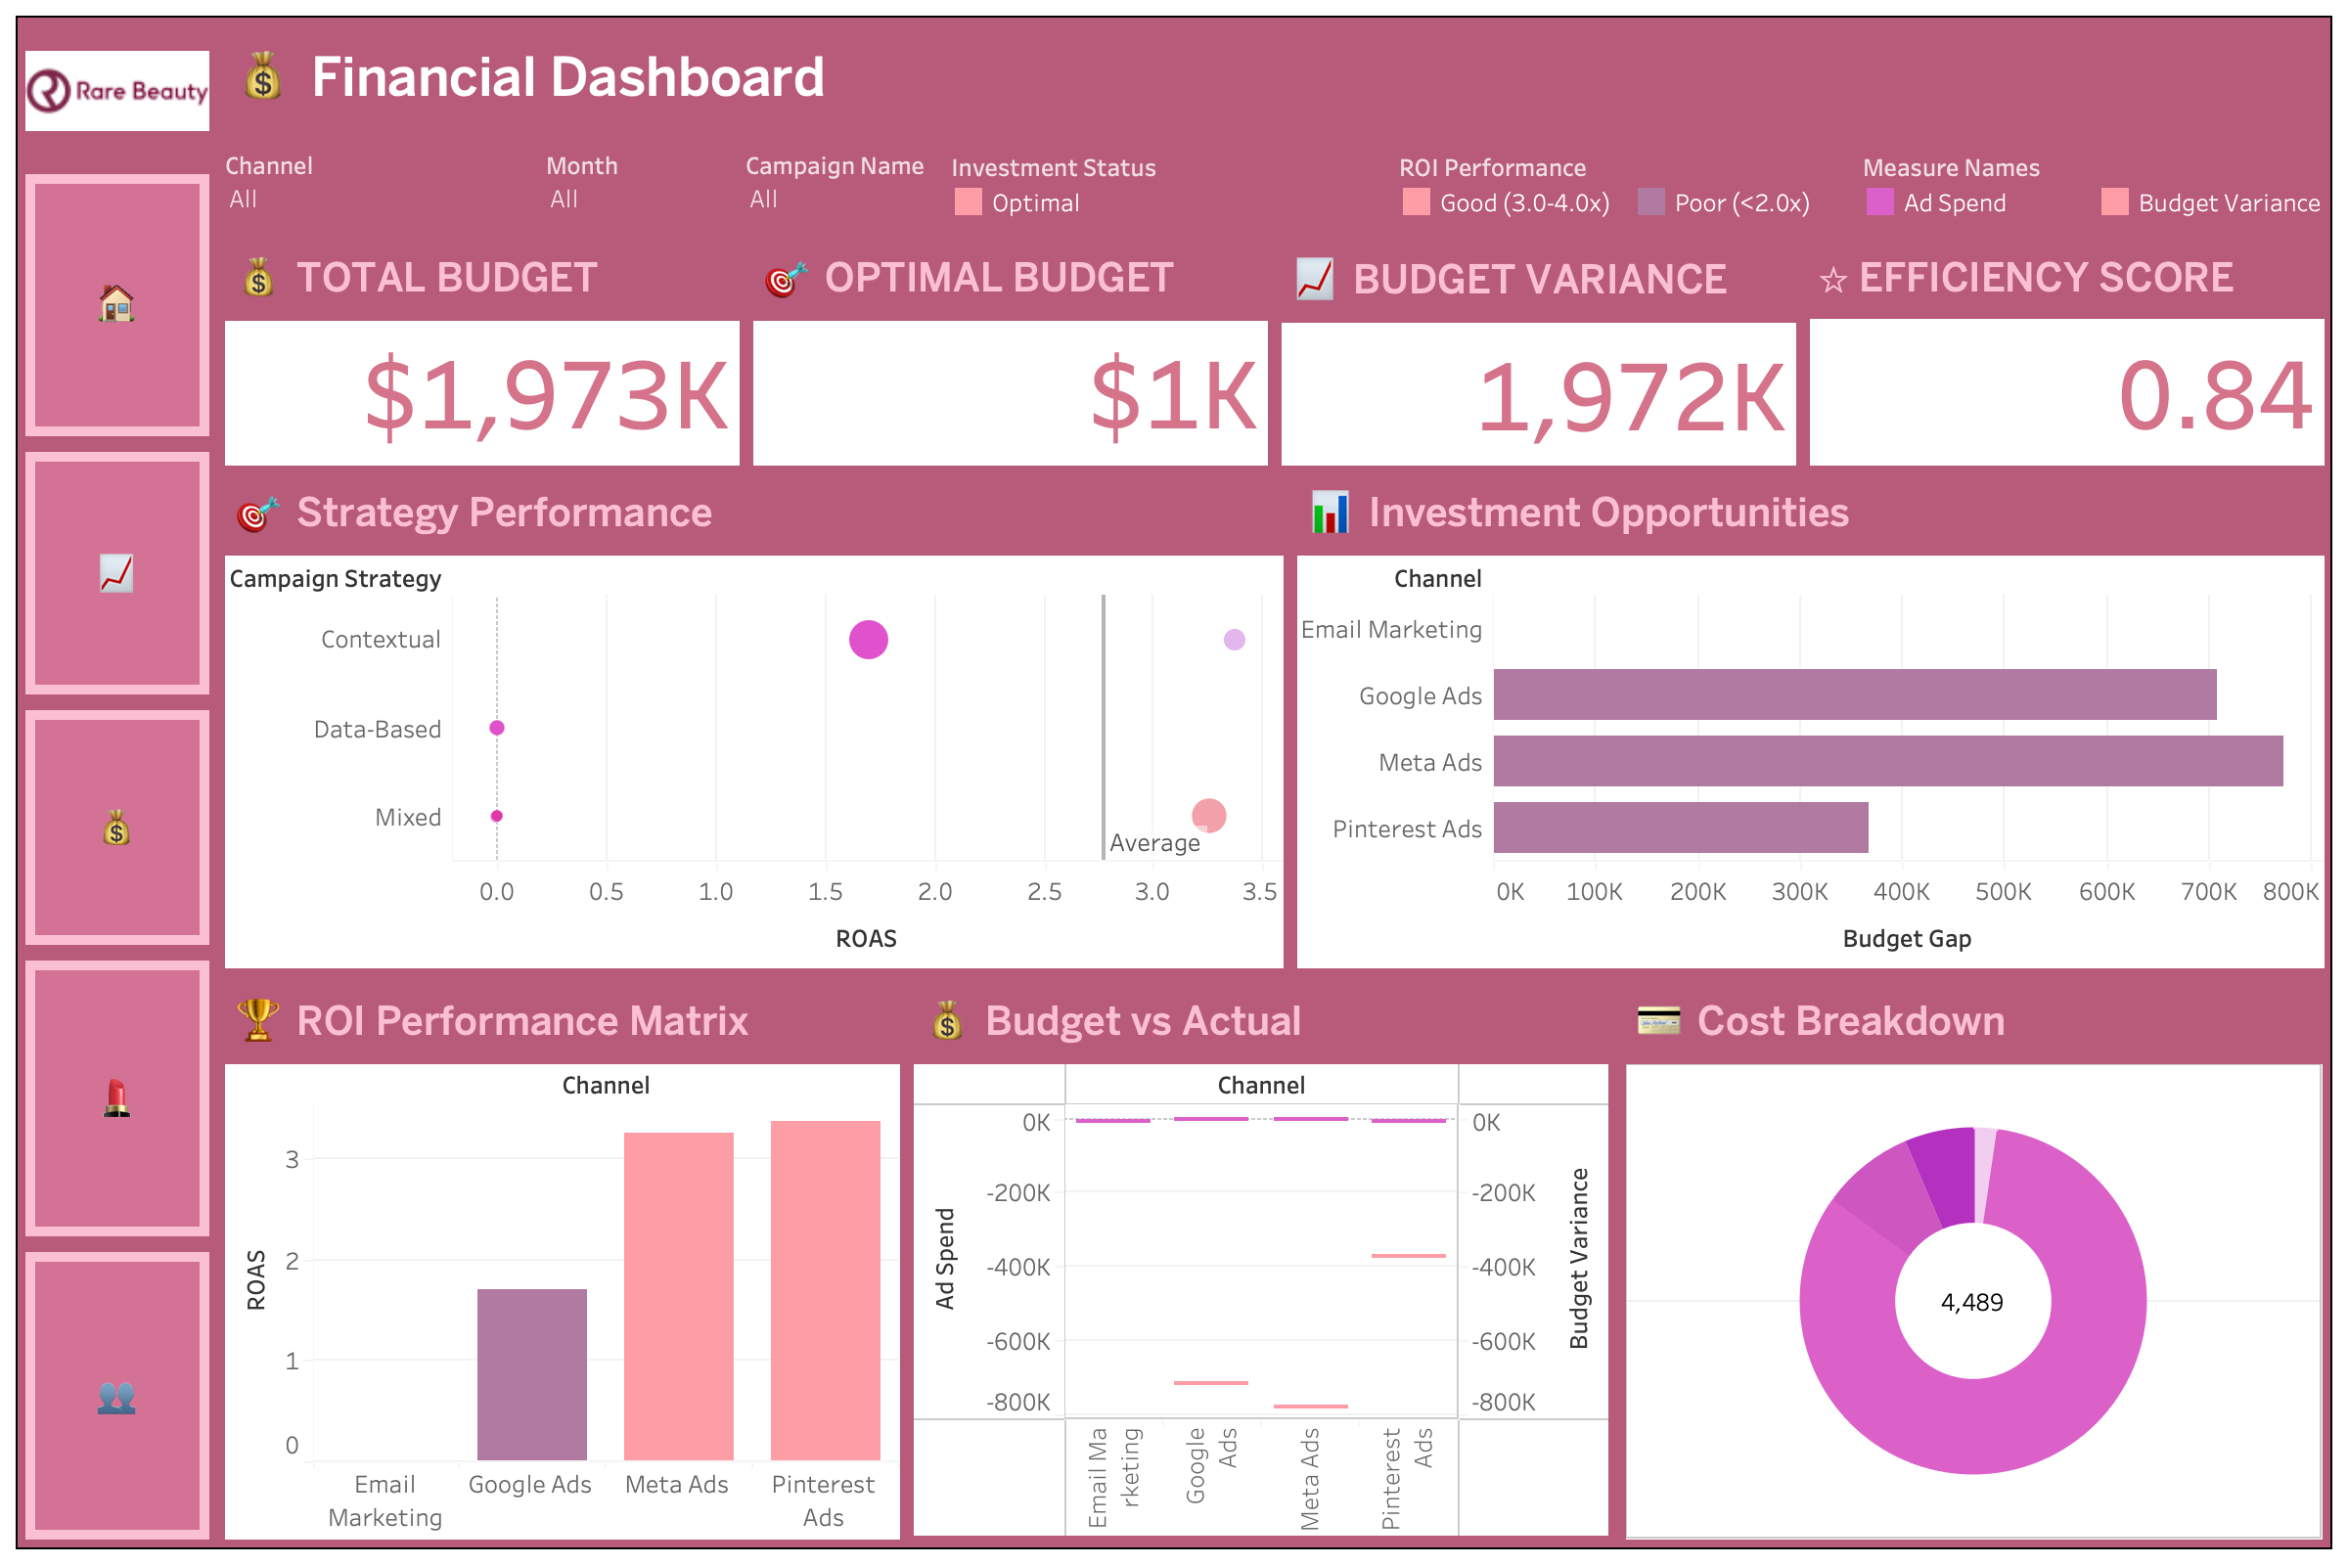
Insights
Efficiency Score: 0.84 → spend not fully optimized
Overfunding in Meta & Pinterest, underfunding in Google Ads + Email
Severe budget overallocation
Email underutilized despite ROI strength
Google Ads underinvested → missed potential
Takeaway: Smarter reallocation could dramatically improve ROI without increasing spend.

Slide 5
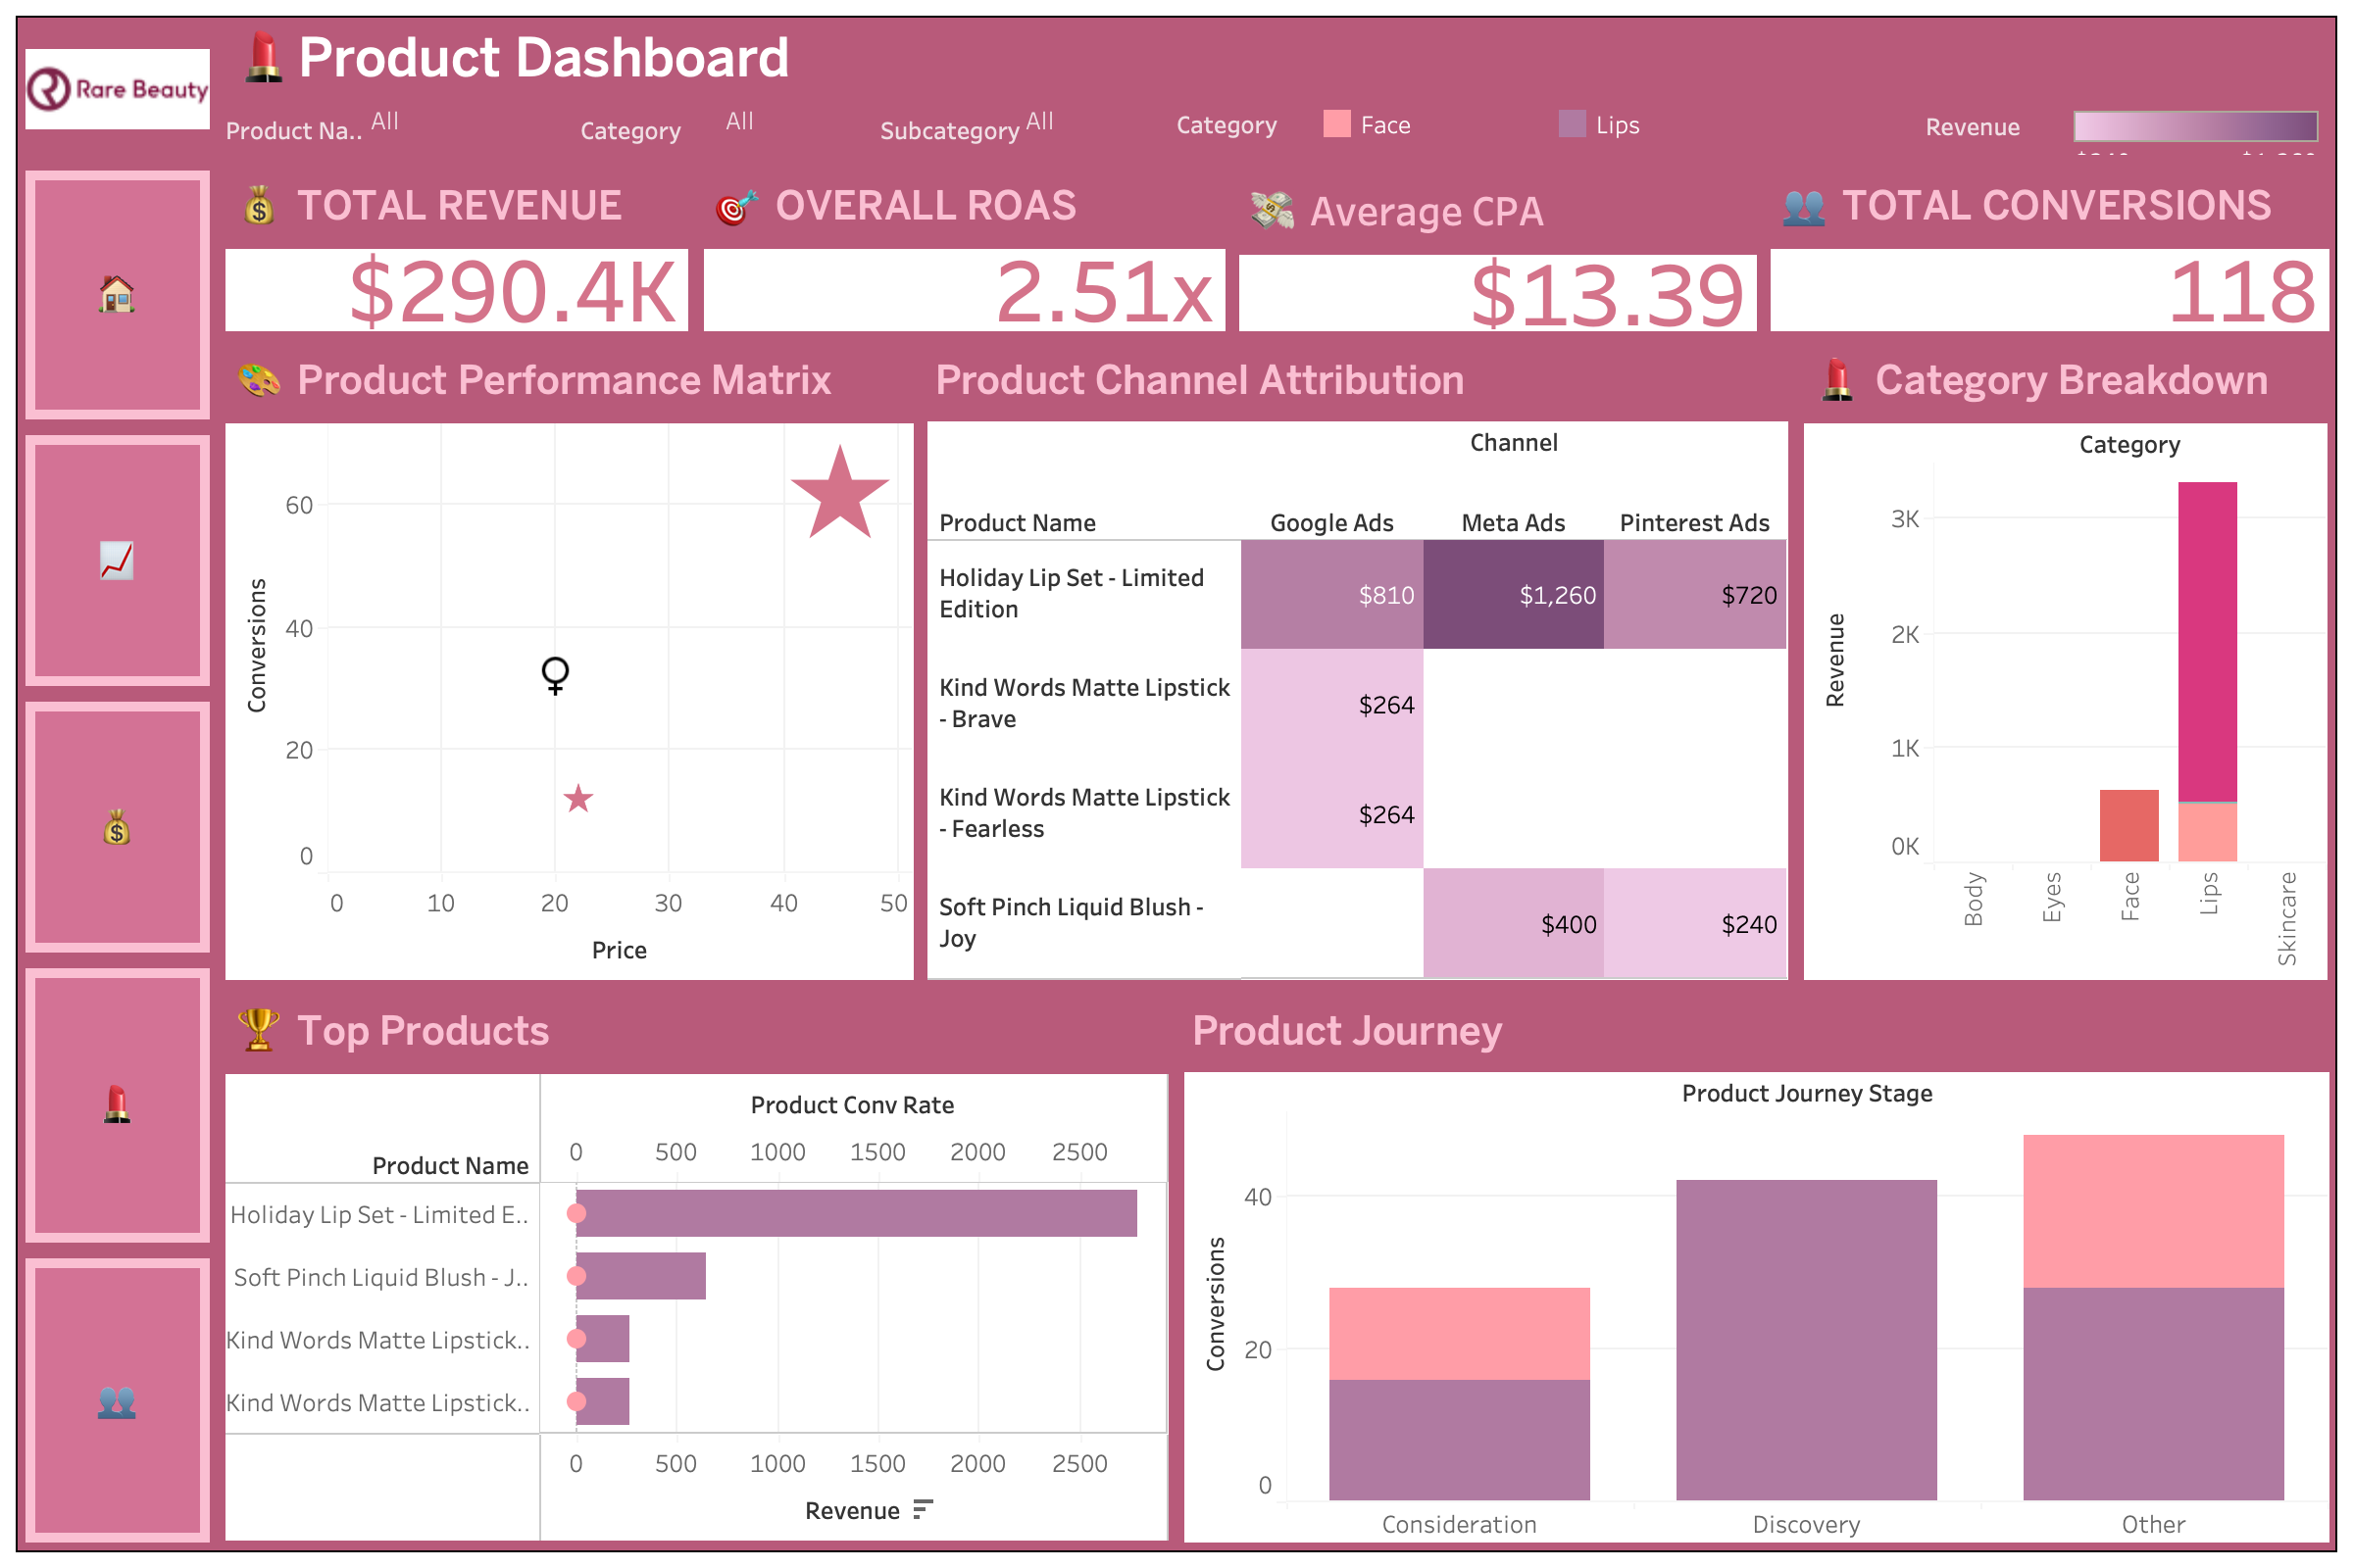
Insights
Top performer: Holiday Lip Set – Limited Edition
Meta & Pinterest drove conversions here
Funnel analysis showed drop-offs in the mid-journey
Takeaway: Strengthen education content + influencer storytelling to move hesitant buyers forward.

Slide 6
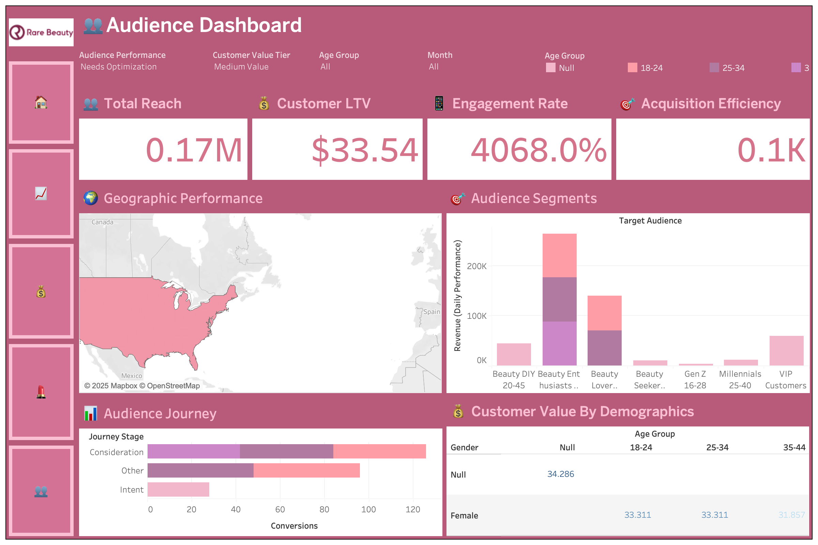
Insights
Total Reach: 170K
Engagement Rate: 4,000%+ (high interaction)
Strongest segments: Gen Z (16–28) & Beauty Enthusiasts (20–45)
Takeaway: Build community-driven loyalty programs & advocacy campaign audiences are primed for it.

